Slide 1
UNIX System Overview
Chapter 1 - Advanced Programming in the UNIX Environment
A comprehensive guide to UNIX fundamentals
Notes:
Welcome to this presentation on UNIX System Overview, based on Chapter 1 of 'Advanced Programming in the UNIX Environment'.
This presentation covers the fundamental concepts of the UNIX operating system from a programmer's perspective, including architecture, file systems, processes, I/O, and more.
These concepts form the foundation for understanding UNIX/Linux programming and system administration.

Slide 2
Table of Contents
1. UNIX Architecture
2. Logging In and Shells
3. Files and Directories
4. Input and Output
5. Programs and Processes
6. Error Handling
7. User Identification
8. Signals
9. Time Values
10. System Calls and Library Functions
Notes:
This presentation covers ten key areas of the UNIX system:
1. The layered architecture of UNIX
2. How users log in and interact with different shells
3. The hierarchical file system structure
4. How input and output operations work
5. Process creation and management
6. Error handling mechanisms
7. User and group identification
8. Signal-based communication
9. How time is represented
10. The difference between system calls and library functions
Each topic builds on the previous ones to provide a comprehensive understanding of UNIX fundamentals.

Slide 3
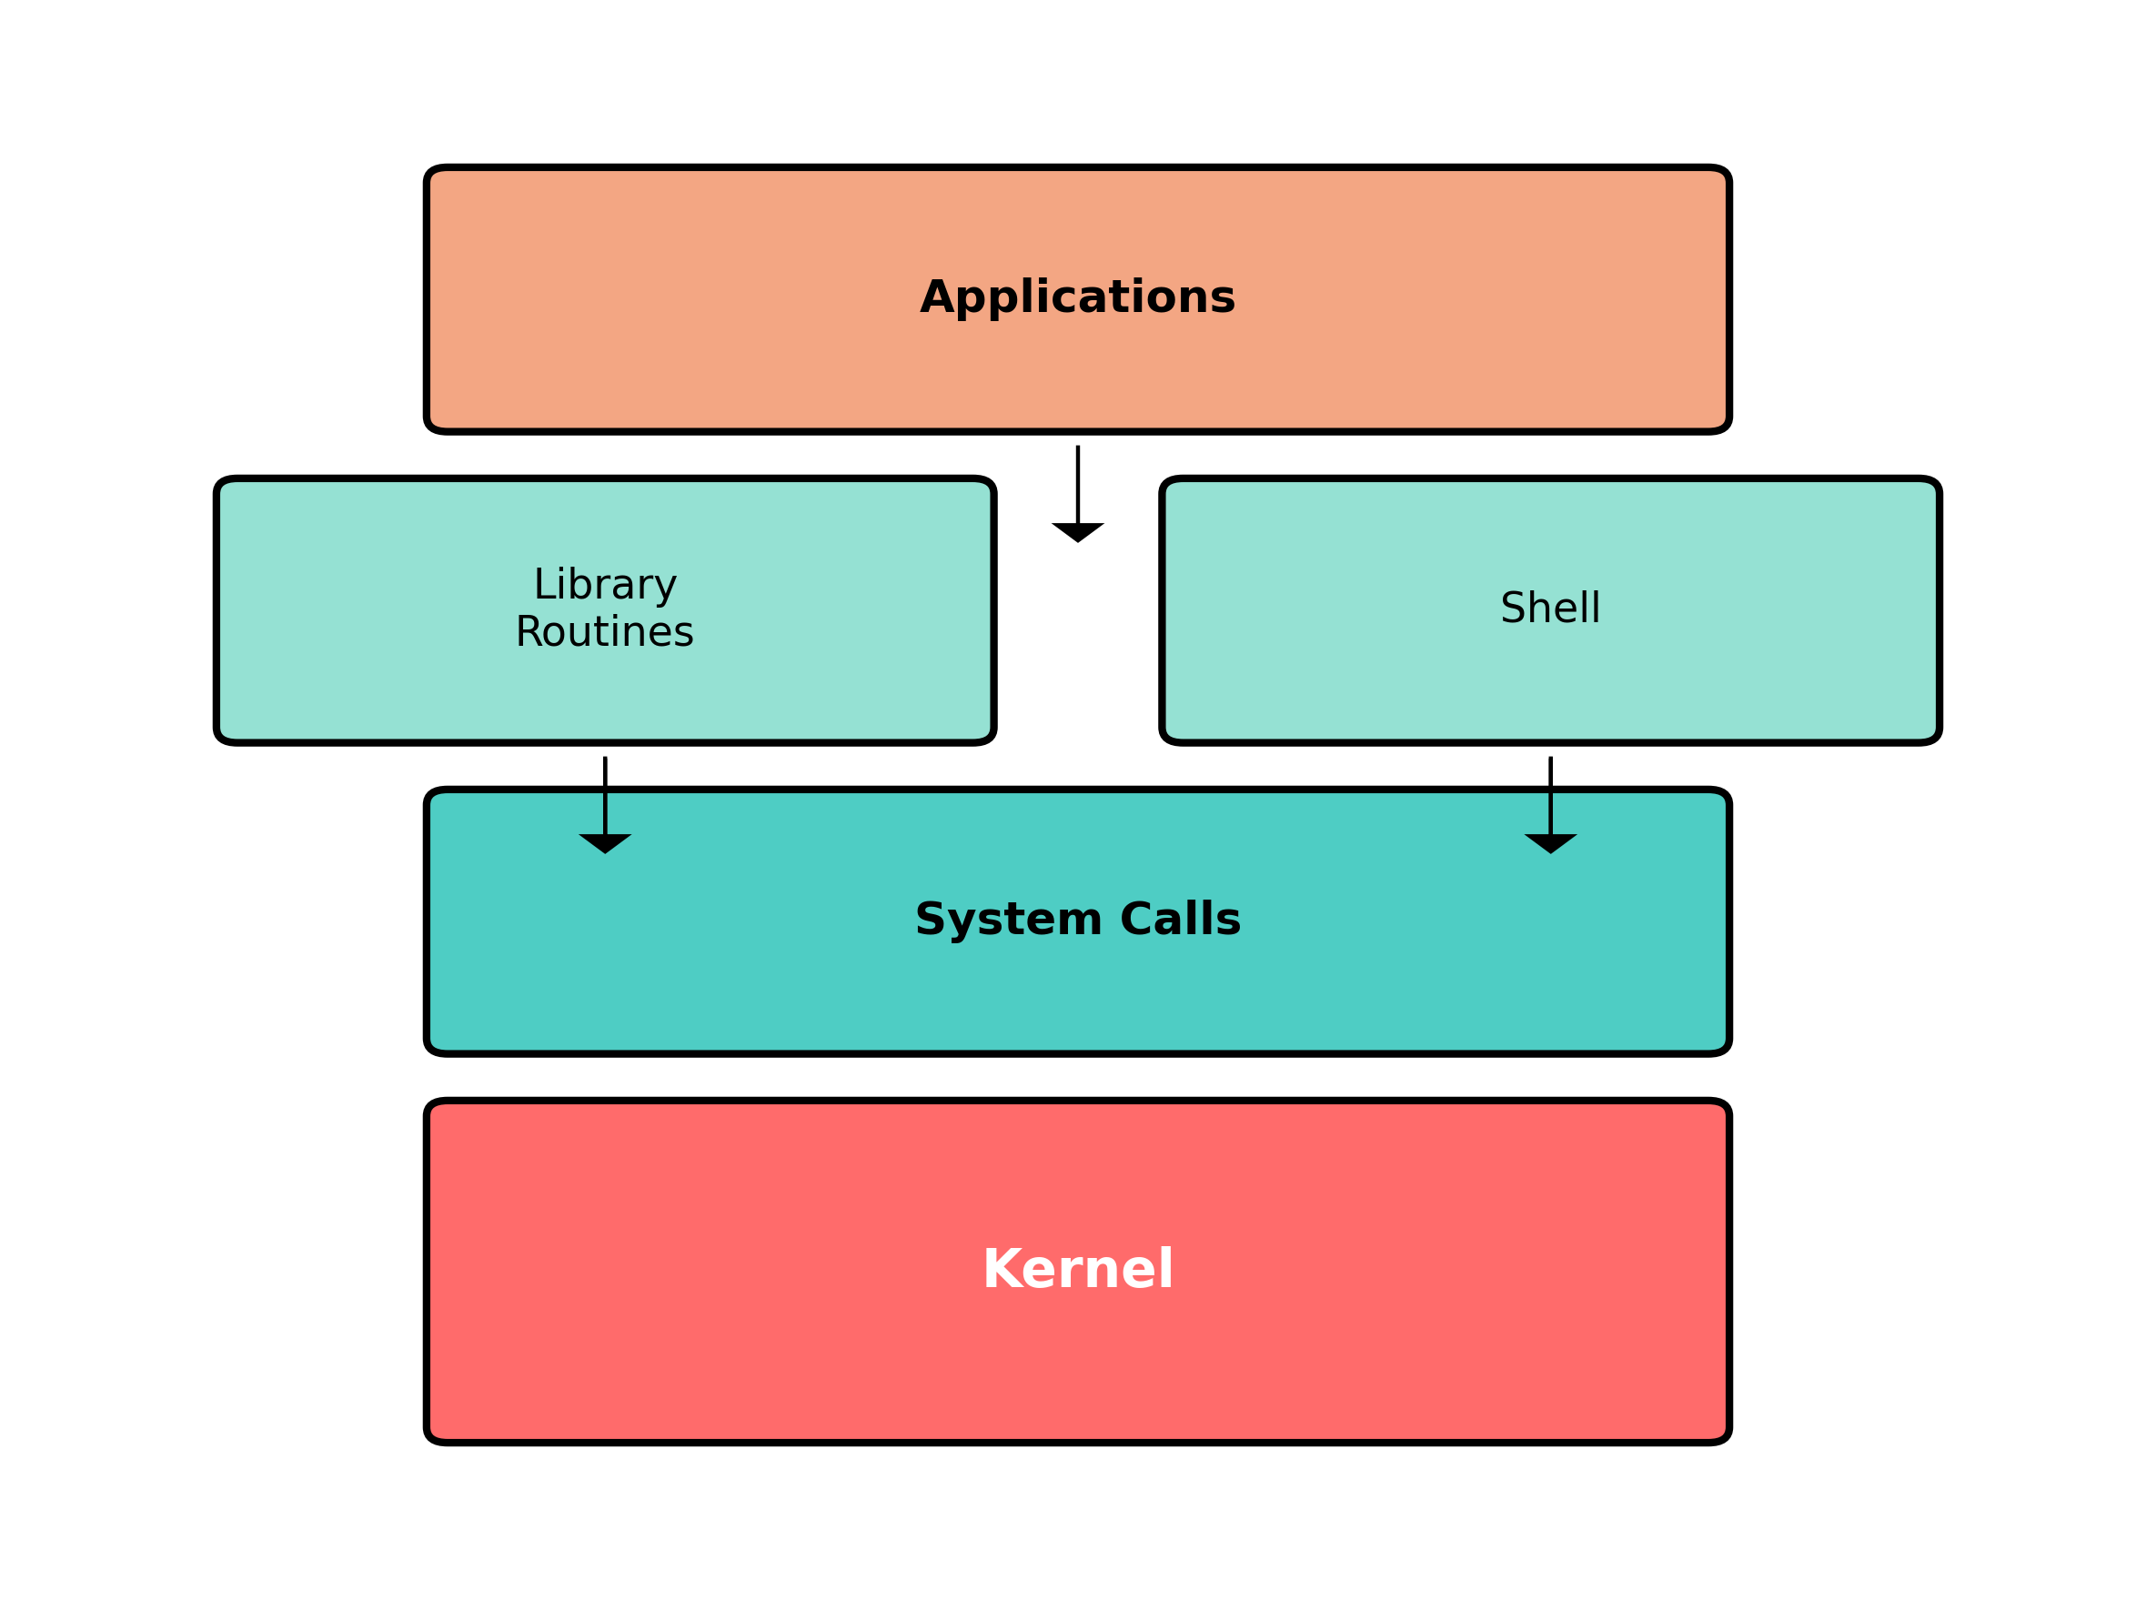
UNIX Architecture
Notes:
The UNIX system has a layered architecture with four main components:
1. Kernel (bottom layer): The core of the operating system that controls hardware resources and provides services to the upper layers. It manages memory, processes, files, and I/O operations.
2. System Calls: The interface between user programs and the kernel. These are entry points into the kernel that provide services like file operations, process control, and device manipulation.
3. Shell and Libraries: The shell is a command interpreter that provides an interface for users. Libraries provide common functions built on top of system calls, making programming easier.
4. Applications: User programs that utilize the services provided by the lower layers.
This layered design provides a clean separation of concerns and allows for modularity in the system.

Slide 4
Key Architecture Concepts
• Kernel: Core of the OS, controls hardware resources
• System Calls: Interface between user programs and kernel
• Library Functions: Built on top of system calls
• Shell: Command-line interpreter
• Applications: User programs that utilize system services
Notes:
Let's explore the key components of the UNIX architecture in more detail:
• The Kernel is the heart of the operating system. It manages hardware resources, schedules processes, handles memory allocation, and provides essential services. It's the only part of the system that interacts directly with hardware.
• System Calls are the API (Application Programming Interface) that the kernel exposes to user programs. Examples include open(), read(), write(), fork(), and exec(). These are the gateway through which applications request services from the kernel.
• Library Functions provide higher-level abstractions built on top of system calls. For example, the printf() function ultimately uses the write() system call, but handles formatting and buffering. Libraries make programming easier and more portable.
• The Shell is a special application that interprets user commands. It provides features like command history, job control, and scripting. Common shells include bash, zsh, and ksh.
• Applications are programs that users interact with directly. They use system calls either directly or through library functions to perform their tasks.

Slide 5
Logging In and Shells
Login Process:
• Enter login name and password
• System checks /etc/passwd file
• Password file contains 7 colon-separated fields:
- Login name
- Encrypted password (moved to separate file)
- User ID (UID)
- Group ID (GID)
- Comment field
- Home directory
- Shell program
Notes:
The login process is the first interaction a user has with a UNIX system:
1. The user enters their login name and password at the login prompt.
2. The system verifies this information against the /etc/passwd file, which contains user account information.
3. The password file contains seven fields separated by colons:
- Login name: The username
- Encrypted password: For security, modern systems store this in a separate file like /etc/shadow
- User ID (UID): A numeric identifier for the user
- Group ID (GID): The primary group the user belongs to
- Comment field: Usually contains the user's full name or other information
- Home directory: Where the user starts when they log in
- Shell program: The command interpreter that runs when the user logs in
For example, an entry might look like:
sar:x:205:105:Stephen Rago:/home/sar:/bin/ksh
After successful authentication, the system sets the user's home directory as the current working directory and launches the specified shell program.

Slide 6
Common UNIX Shells
• Bourne Shell (/bin/sh)
- Original shell from Version 7
- Available on almost all UNIX systems
• C Shell (/bin/csh)
- Developed at Berkeley
- C-like syntax, job control, history
• Korn Shell (/bin/ksh)
- Successor to Bourne shell
- Combines best features
• Bourne-again Shell (/bin/bash)
- GNU shell, default on Linux
- POSIX conformant
Notes:
Several shells are available in UNIX systems, each with different features and syntax:
• Bourne Shell (/bin/sh): Developed by Steve Bourne at Bell Labs, this was the original UNIX shell. It's known for its simplicity and scripting capabilities. Its control-flow constructs resemble Algol 68. It's still the most portable shell across different UNIX variants.
• C Shell (/bin/csh): Developed by Bill Joy at Berkeley, it introduced features like command history, aliases, and job control. Its syntax resembles the C programming language, making it popular among programmers. The TENEX C shell (tcsh) is an enhanced version with additional features.
• Korn Shell (/bin/ksh): Developed by David Korn at Bell Labs, it's backward compatible with the Bourne shell but adds many C shell features. It became the standard shell in System V Release 4.
• Bourne-again Shell (/bin/bash): Developed by the GNU Project, it's the default shell on most Linux distributions. It combines features from both the Bourne shell and C shell, and is POSIX compliant.
The shell specified in the user's password file entry is started automatically when they log in. Users can switch between shells during a session by simply typing the shell name.

Slide 7
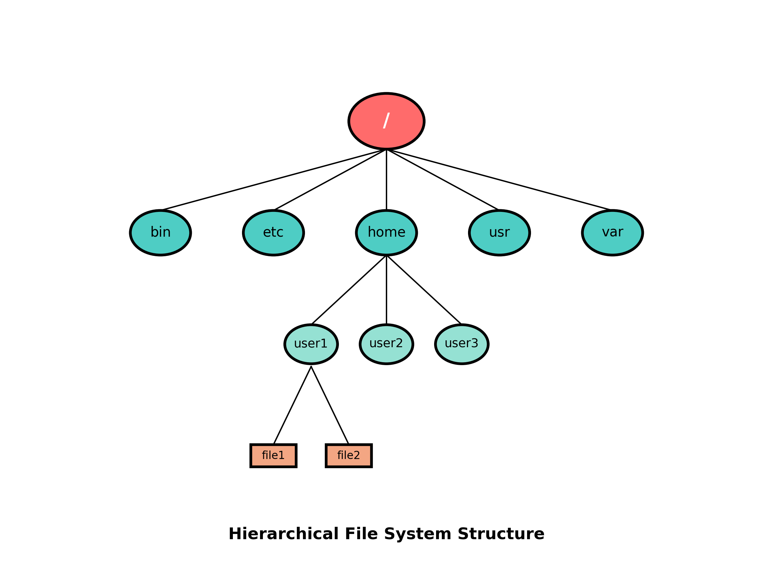
UNIX File System Structure
Notes:
The UNIX file system has a hierarchical tree structure:
• Everything starts at the root directory, represented by a single forward slash (/).
• Standard directories include:
- /bin: Essential command binaries
- /etc: System configuration files
- /home: User home directories
- /usr: User utilities and applications
- /var: Variable data files (logs, mail, etc.)
• Each user typically has a home directory under /home (e.g., /home/user1).
• Files and directories form a tree, with directories able to contain both files and other directories.
• The file system is unified - all devices and resources appear within this single hierarchy, unlike systems with drive letters.
• Pathnames can be absolute (starting from root with /) or relative (starting from the current working directory).
This hierarchical organization makes it easy to organize and locate files, and provides a consistent interface for accessing all system resources.

Slide 8
File System Concepts
• Everything starts at root (/)
• Directories contain directory entries
• File attributes:
- Type (regular file, directory)
- Size
- Owner
- Permissions
- Modification time
• Special directories:
- . (dot) = current directory
- .. (dot-dot) = parent directory
Notes:
Key file system concepts in UNIX:
• The root directory (/) is the starting point of the file system hierarchy. All files and directories are accessed through paths that begin at root.
• A directory is a special type of file that contains directory entries. Each entry associates a filename with an inode (a data structure containing file metadata).
• Every file has several attributes:
- Type: Regular file, directory, symbolic link, character device, block device, socket, or FIFO
- Size: Size in bytes
- Owner: User ID of the file owner
- Group: Group ID associated with the file
- Permissions: Read, write, and execute permissions for owner, group, and others
- Timestamps: Last access time, last modification time, and status change time
• Special directory entries:
- . (dot): References the current directory
- .. (dot-dot): References the parent directory
- In the root directory, dot-dot refers to the root itself
• Filenames can contain any character except / (which separates path components) and the null character (which terminates strings in C). However, it's good practice to use only letters, numbers, periods, dashes, and underscores for portability.
• The stat() and fstat() functions can be used to retrieve all the attributes of a file.

Slide 9
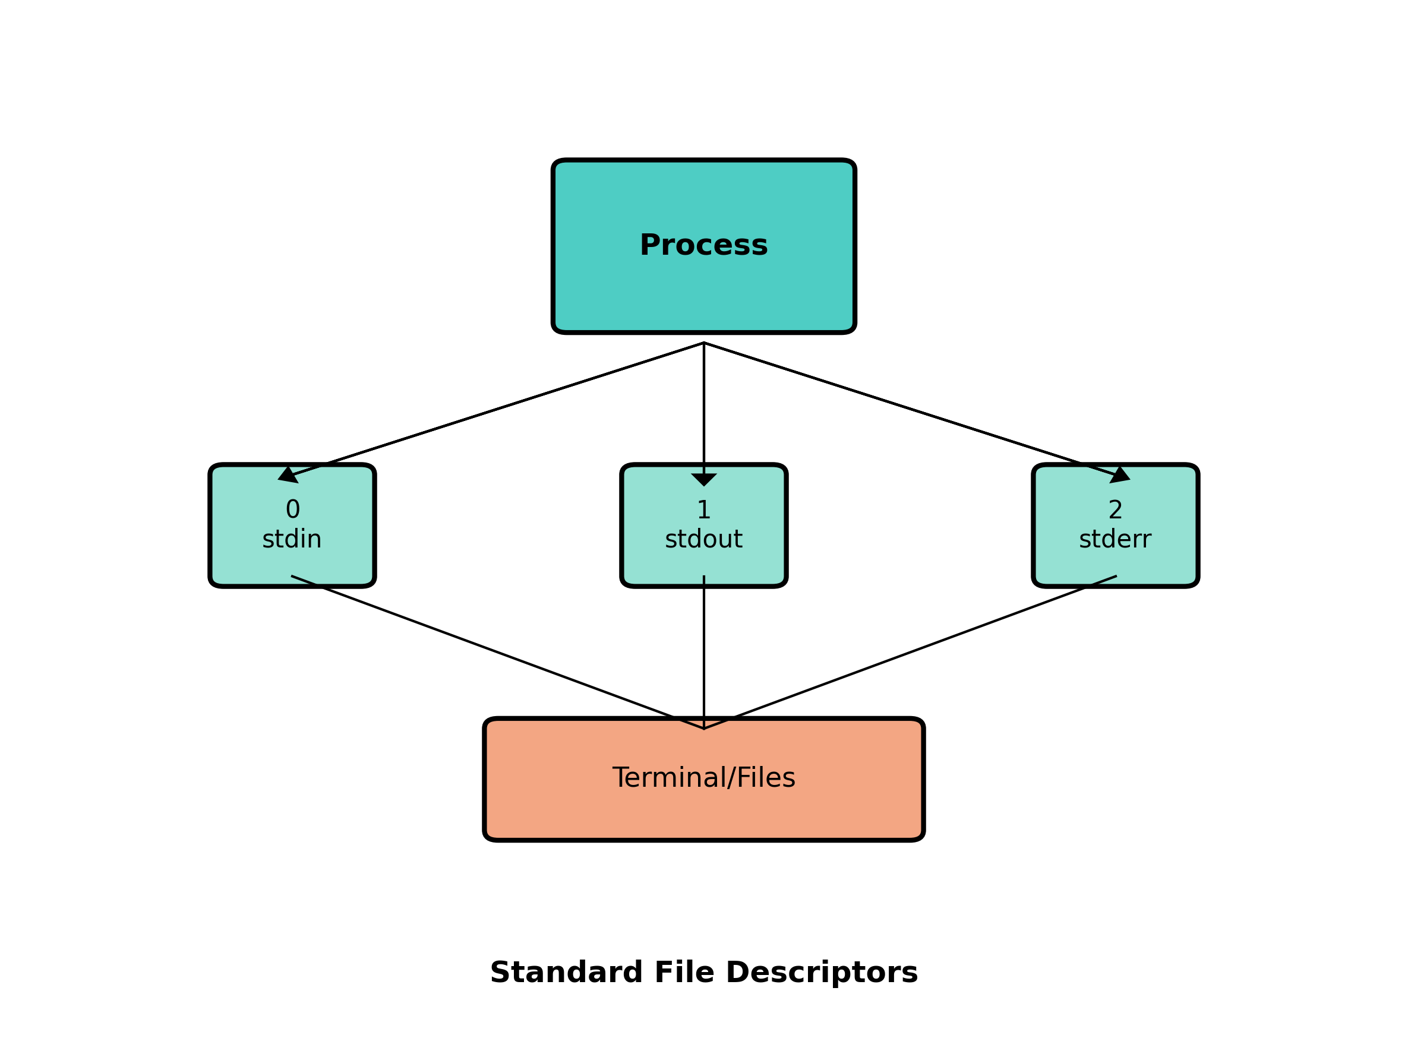
UNIX I/O Model
Notes:
The UNIX I/O model is based on file descriptors:
• A file descriptor is a small non-negative integer that the kernel uses to identify files accessed by a process.
• When a process starts, it automatically has three standard file descriptors open:
- 0: Standard input (stdin) - where the process reads input
- 1: Standard output (stdout) - where the process writes output
- 2: Standard error (stderr) - where the process writes error messages
• By default, all three are connected to the terminal, but they can be redirected to files or other devices using shell operators:
- < redirects stdin
- > redirects stdout
- 2> redirects stderr
• Example: ls > file.list runs the ls command with its standard output redirected to file.list
• The same file descriptor concept applies to all I/O operations, not just the standard streams. When you open a file, the kernel returns a file descriptor that you use for subsequent operations on that file.
• This unified I/O model is one of UNIX's most powerful features - it treats all input/output sources (files, devices, network connections, etc.) using the same interface.

Slide 10
Types of I/O in UNIX
Unbuffered I/O:
• Direct system calls: open, read, write, close
• Works with file descriptors
• No automatic buffering
Standard I/O:
• Library functions: fopen, fgets, printf
• Automatic buffering for efficiency
• Works with FILE pointers
• Built on top of unbuffered I/O
Notes:
UNIX provides two main types of I/O interfaces:
1. Unbuffered I/O:
• Provided by system calls: open(), read(), write(), close(), lseek()
• Works directly with file descriptors
• Called 'unbuffered' because each read or write operation invokes a system call
• The programmer must manage buffer sizes and data transfer
• Example: read(fd, buffer, size) reads up to 'size' bytes into 'buffer' from file descriptor 'fd'
• Provides fine-grained control but requires more programming effort
2. Standard I/O:
• Provided by the C library: fopen(), fread(), fprintf(), fgets(), etc.
• Works with FILE pointers instead of file descriptors
• Implements buffering automatically to reduce system call overhead
• Handles line-oriented input and formatted output
• Easier to use for most applications
• Example: printf("Hello, %s\n", name) formats and outputs a string
• Built on top of the unbuffered I/O functions
Most applications use standard I/O for convenience, but performance-critical or specialized applications might use unbuffered I/O for more control.

Slide 11
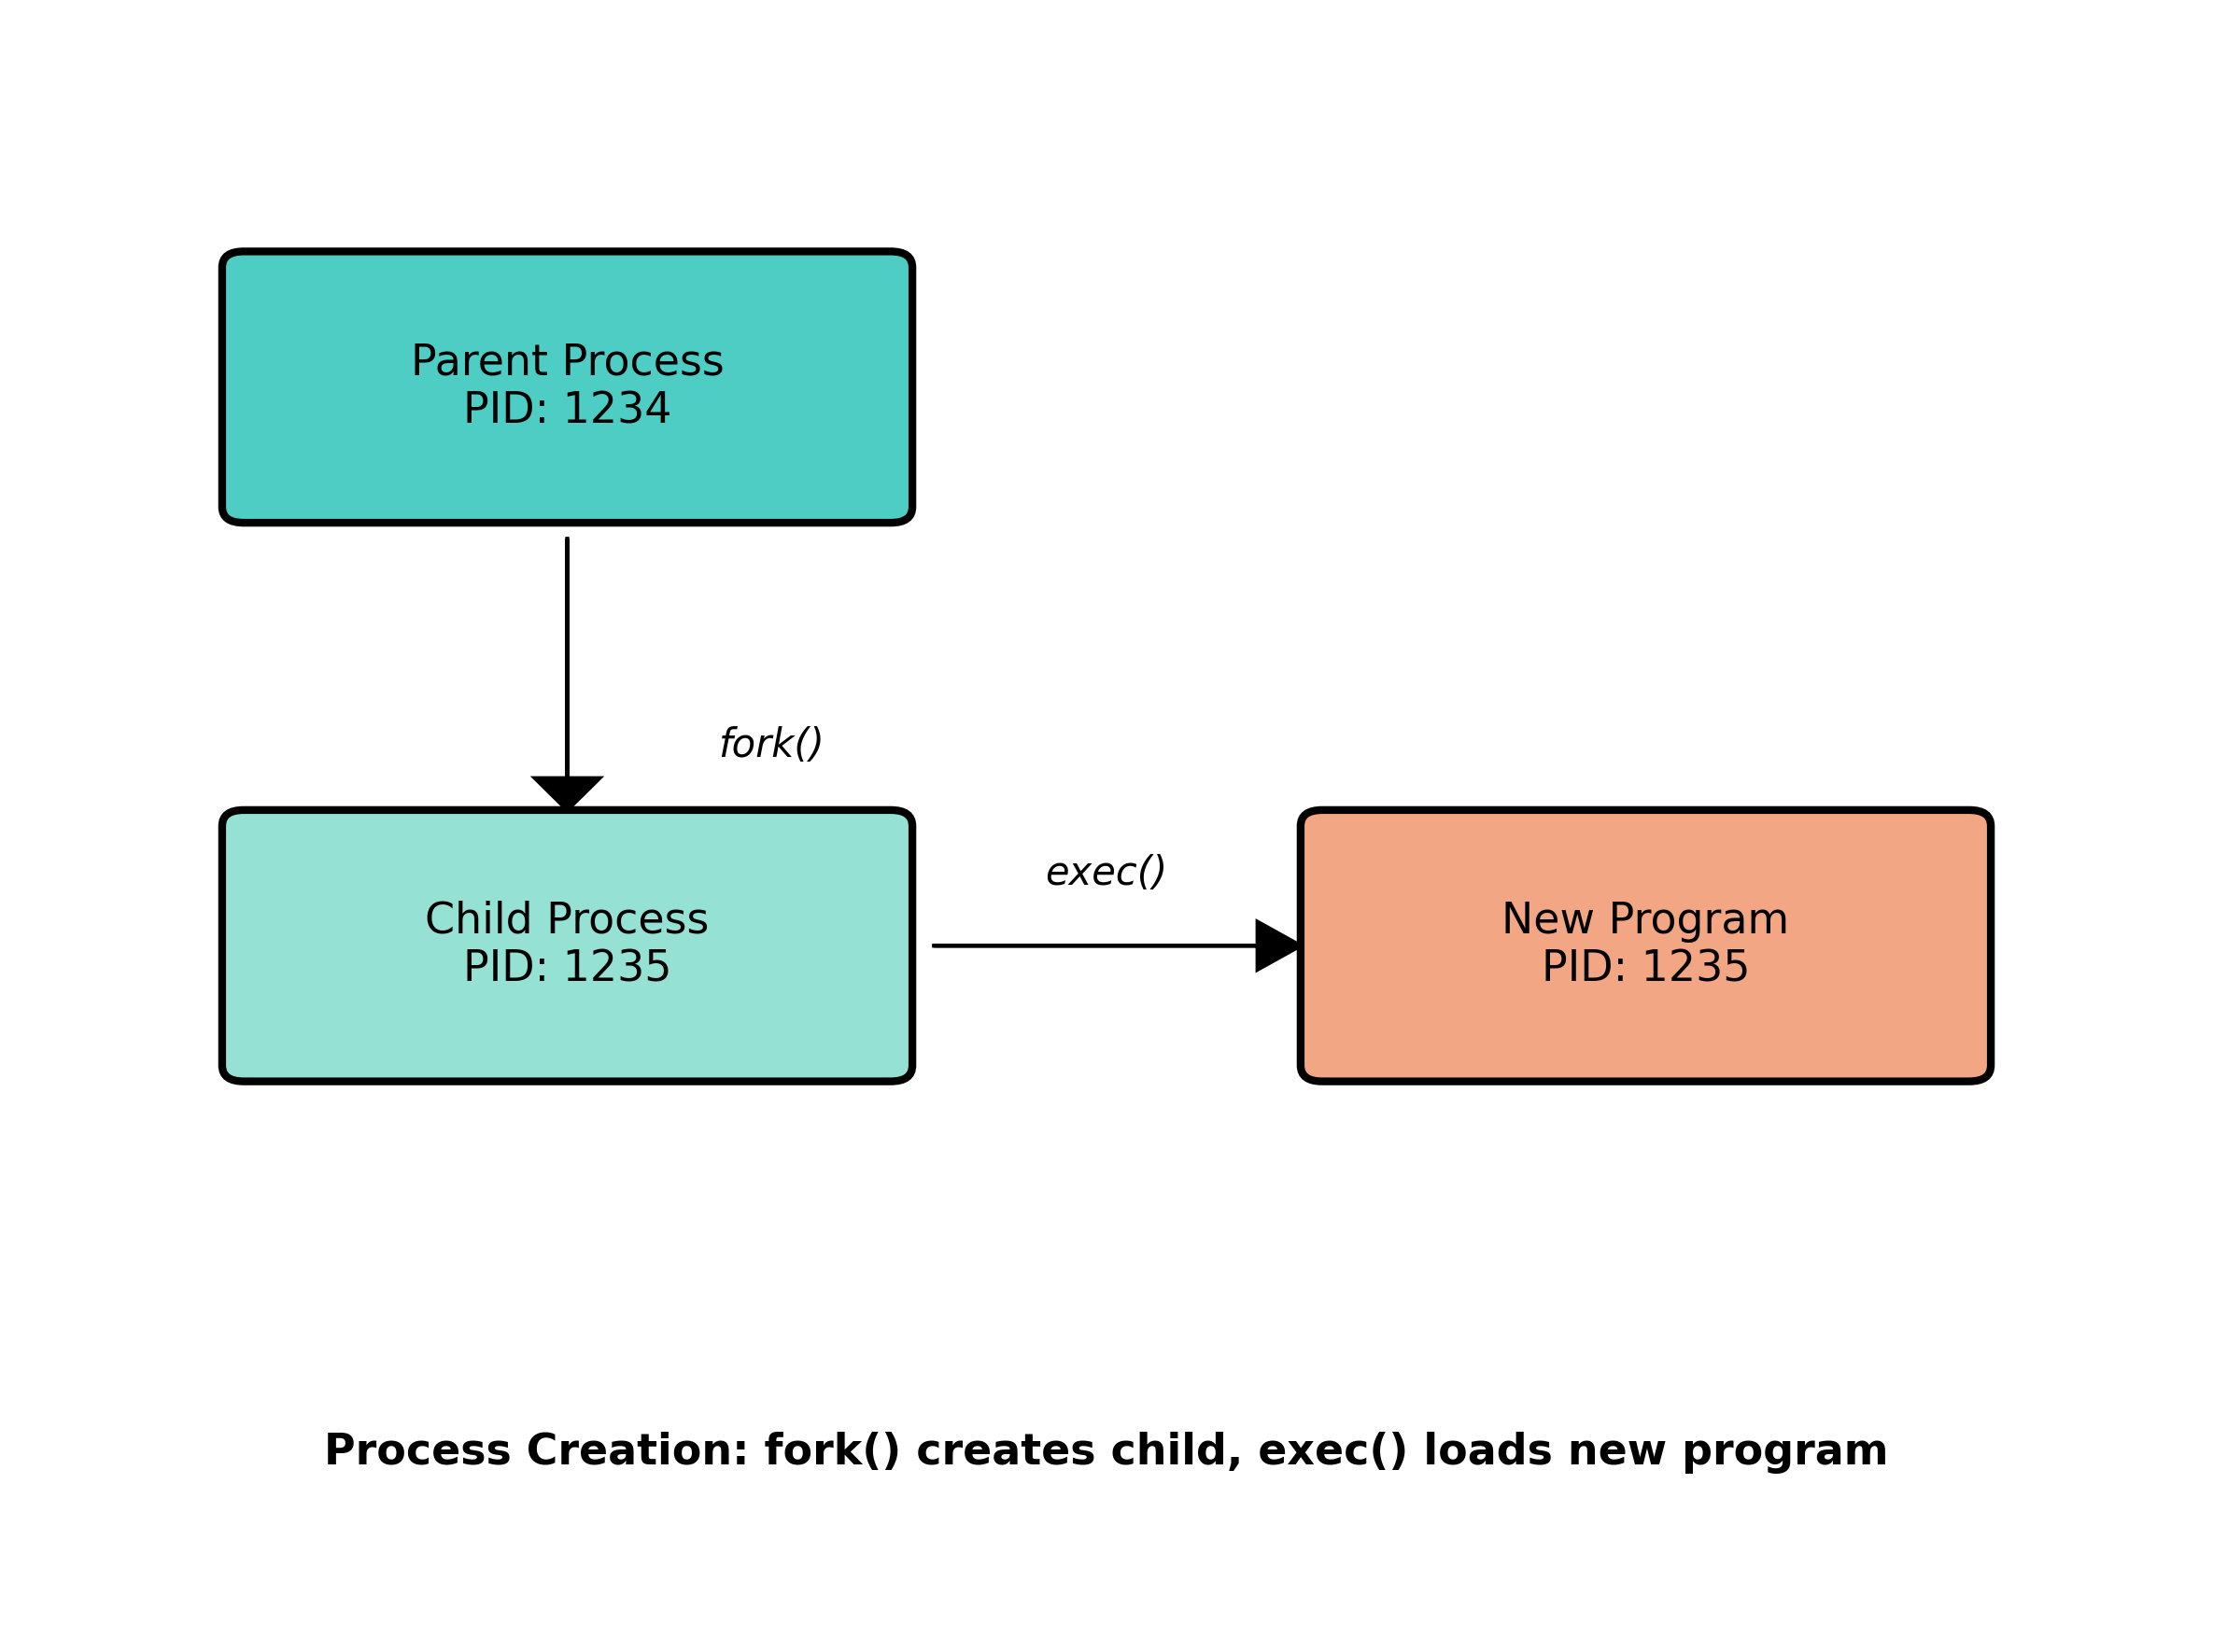
Process Creation Model
Notes:
The UNIX process creation model uses two key system calls:
1. fork():
• Creates a new process by duplicating the calling process
• The new process (child) is an exact copy of the original process (parent)
• After fork(), two processes run the same program
• fork() returns twice: returns the child's PID to the parent, and returns 0 to the child
• This allows different code paths for parent and child
• The child inherits open files, current working directory, and most other attributes
2. exec():
• Replaces the current process image with a new program
• Loads the new program into the current process space
• Does not create a new process - the PID remains the same
• There are several variants (execl, execv, execlp, etc.) with different ways to specify arguments
3. waitpid():
• Used by a parent to wait for a child process to terminate
• Returns the termination status of the child
• Prevents zombie processes (terminated processes whose exit status hasn't been collected)
This two-step process (fork followed by exec) provides flexibility. For example, the child can modify its environment before executing a new program. This model is used by shells to execute commands and by many other UNIX utilities.

Slide 12
Process Control Functions
Key Functions:
• fork() - Create a new process
- Returns PID to parent
- Returns 0 to child
• exec() family - Replace process image
- execl, execv, execle, etc.
• waitpid() - Wait for child process
- Returns termination status
• getpid() - Get process ID
• exit() - Terminate process
Notes:
UNIX provides several key functions for process control:
• fork(): Creates a child process that is a copy of the parent.
- Called once but returns twice: once in the parent and once in the child
- In the parent, it returns the child's PID (a positive integer)
- In the child, it returns 0
- If an error occurs, it returns -1
- Example: if ((pid = fork()) < 0) { /* error */ } else if (pid == 0) { /* child */ } else { /* parent */ }
• exec() family: Replaces the current process image with a new program.
- execl(), execv(), execle(), execve(), execlp(), execvp(), fexecve()
- Different variants allow different ways to specify arguments and environment
- If successful, exec never returns to the calling program
- Example: execlp("ls", "ls", "-l", NULL);
• waitpid(): Allows a parent to wait for a child to terminate.
- Can wait for a specific child or any child
- Returns the PID of the terminated child and stores its exit status
- Example: waitpid(pid, &status, 0);
• getpid(): Returns the process ID of the calling process.
- Useful for logging, creating unique temporary files, etc.
• exit(): Terminates the calling process.
- Takes an exit status as an argument (0 for success, non-zero for error)
- Flushes and closes open files, calls exit handlers registered with atexit()
- Example: exit(0);
These functions form the basis of process management in UNIX systems.

Slide 13
Error Handling in UNIX
Error Indication:
• Functions return -1 on error
• errno variable set to indicate error type
• Error constants begin with 'E' (EACCES, ENOENT, etc.)
Error Reporting Functions:
• strerror(errno) - Get error message string
• perror("message") - Print error to stderr
Error Types:
• Fatal errors - No recovery possible
• Non-fatal errors - Can retry (EAGAIN, EBUSY, etc.)
Notes:
Error handling in UNIX follows a consistent pattern:
1. Error Indication:
• Most system calls return -1 on error and set the global variable errno
• Functions that return pointers typically return NULL on error
• The errno variable contains a code indicating what went wrong
• Error codes are defined in <errno.h> as constants starting with E
• Examples: EACCES (permission denied), ENOENT (no such file), EINTR (interrupted system call)
2. Error Reporting Functions:
• strerror(errno): Returns a pointer to a string describing the error
• perror("prefix"): Prints a message to stderr consisting of the string prefix, a colon, and the error description
• Example:
```
if (open("file", O_RDONLY) < 0) {
fprintf(stderr, "Error: %s\n", strerror(errno));
perror("open");
}
```
3. Error Types:
• Fatal errors: No recovery action is possible (e.g., out of memory)
• Non-fatal errors: May be temporary and can be retried
• Resource-related non-fatal errors include EAGAIN, ENFILE, ENOSPC, etc.
• Recovery strategies include delaying and retrying, or using alternative resources
Good error handling is essential for robust applications. Always check return values from system calls and library functions, and provide meaningful error messages to users or log files.

Slide 14
User and Group Identification
User ID (UID):
• Numeric identifier for each user
• UID 0 = root (superuser)
• Used for permission checks
Group ID (GID):
• Numeric identifier for groups
• Users can belong to multiple groups
• Facilitates resource sharing
Functions:
• getuid() - Get user ID
• getgid() - Get group ID
Notes:
UNIX systems use numeric IDs to identify users and groups:
1. User ID (UID):
• Every user has a unique numeric user ID
• UID 0 is special - it belongs to the root user (superuser)
• The superuser has special privileges and can bypass most permission checks
• UIDs are assigned by the system administrator when creating user accounts
• The kernel uses UIDs to determine file access permissions and other security checks
• Modern systems use 32-bit integers for UIDs (older systems used 16-bit)
2. Group ID (GID):
• Users are organized into groups for permission management
• Each group has a unique numeric group ID
• A user has a primary group (specified in /etc/passwd) and can belong to additional groups
• Supplementary groups are listed in /etc/group
• Groups facilitate sharing resources among users
• Example: all developers might be in a 'dev' group with access to project files
3. Key Functions:
• getuid(): Returns the real user ID of the calling process
• geteuid(): Returns the effective user ID (may differ from real UID when executing setuid programs)
• getgid(): Returns the real group ID
• getegid(): Returns the effective group ID
• getgroups(): Returns the supplementary group IDs
The mapping between numeric IDs and names is stored in /etc/passwd (for users) and /etc/group (for groups). Commands like ls display names instead of numbers for better readability.

Slide 15
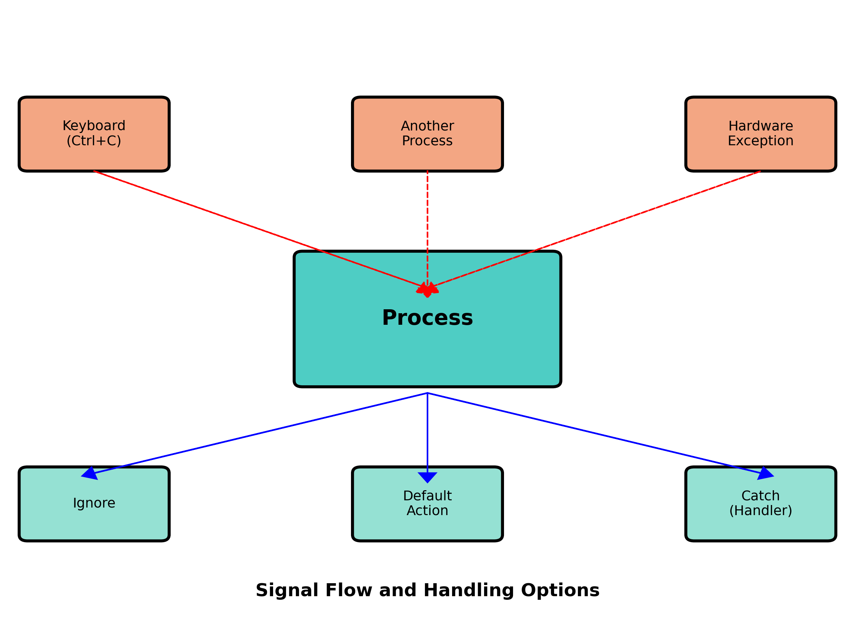
UNIX Signals
Notes:
Signals are a mechanism for notifying processes of events:
1. Signal Sources:
• Terminal input: Ctrl+C generates SIGINT, Ctrl+\ generates SIGQUIT
• Hardware exceptions: Division by zero generates SIGFPE, illegal memory access generates SIGSEGV
• Software conditions: Child process termination sends SIGCHLD to parent
• Explicit requests: The kill command or kill() function can send signals between processes
2. Signal Handling Options:
• Ignore the signal: The process can tell the kernel to ignore a signal (except for SIGKILL and SIGSTOP)
• Let the default action occur: Each signal has a default action (usually terminate the process)
• Catch the signal: Specify a function to be called when the signal occurs
3. Signal Flow:
• When an event occurs, the kernel generates a signal for the target process
• The process responds based on how it has configured handling for that signal
• If the process catches the signal, normal execution is suspended, the signal handler runs, and then execution resumes
Signals provide a way for processes to respond to asynchronous events. They're used for everything from handling user interrupts to implementing daemon process control to managing child processes.

Slide 16
Common UNIX Signals
• SIGINT - Interrupt (Ctrl+C)
• SIGQUIT - Quit (Ctrl+\)
• SIGKILL - Kill (cannot be caught)
• SIGTERM - Termination request
• SIGFPE - Floating point exception
• SIGSEGV - Segmentation violation
• SIGCHLD - Child process terminated
• SIGALRM - Alarm clock
Signal Handling:
• signal() function to set handler
• Handler function called when signal received
Notes:
Common UNIX signals and their purposes:
• SIGINT (2): Interrupt from keyboard (Ctrl+C)
- Default: Terminate process
- Typical use: User wants to stop a program
• SIGQUIT (3): Quit from keyboard (Ctrl+\)
- Default: Terminate process and dump core
- More severe than SIGINT, used for debugging
• SIGKILL (9): Kill signal
- Default: Terminate process (cannot be caught or ignored)
- Used when a process must be stopped immediately
- Last resort when other signals don't work
• SIGTERM (15): Termination signal
- Default: Terminate process
- Standard way to ask a process to terminate gracefully
- Used by shutdown and kill commands by default
• SIGFPE (8): Floating point exception
- Default: Terminate process and dump core
- Caused by arithmetic errors like division by zero
• SIGSEGV (11): Segmentation violation
- Default: Terminate process and dump core
- Caused by invalid memory references
• SIGCHLD (17): Child process terminated
- Default: Ignore
- Sent to parent when a child process terminates
- Used to implement wait() functionality
• SIGALRM (14): Alarm clock
- Default: Terminate process
- Generated when an alarm set by alarm() expires
- Used for timeouts
Signal handling is set up with the signal() function:
```c
void handler(int signo) { /* handle signal */ }
signal(SIGINT, handler); // Register handler for SIGINT
```
Modern programs often use the more flexible sigaction() function instead of signal().

Slide 17
UNIX Time Values
Calendar Time:
• Seconds since Epoch (Jan 1, 1970 00:00:00 UTC)
• Stored in time_t type
• Used for file timestamps
Process Time:
• CPU time used by process
• Measured in clock ticks
• Three components:
- Clock time (wall clock)
- User CPU time
- System CPU time
Notes:
UNIX systems maintain two different types of time values:
1. Calendar Time:
• Counts seconds since the Epoch: 00:00:00 January 1, 1970, Coordinated Universal Time (UTC)
• Stored in the time_t data type (typically a 32-bit or 64-bit integer)
• Used for file timestamps, scheduling, and other time-based operations
• Obtained with time() function
• A 32-bit time_t will overflow in January 2038 (the "Year 2038 problem")
• Most modern systems now use 64-bit time_t to avoid this issue
• Library functions like localtime() convert this value to human-readable form
2. Process Time:
• Measures CPU resources used by a process
• Measured in clock ticks (historically 50, 60, or 100 ticks per second)
• Stored in the clock_t data type
• Three components are tracked:
- Clock time (wall clock time): Real elapsed time, affected by system load
- User CPU time: Time spent executing user code
- System CPU time: Time spent in kernel on behalf of the process
• Total CPU time = User time + System time
• Obtained with times() function or clock() function
• The time command shows all three values for a process
The separation of calendar time and process time allows for accurate tracking of both real-world time and computational resources used.

Slide 18
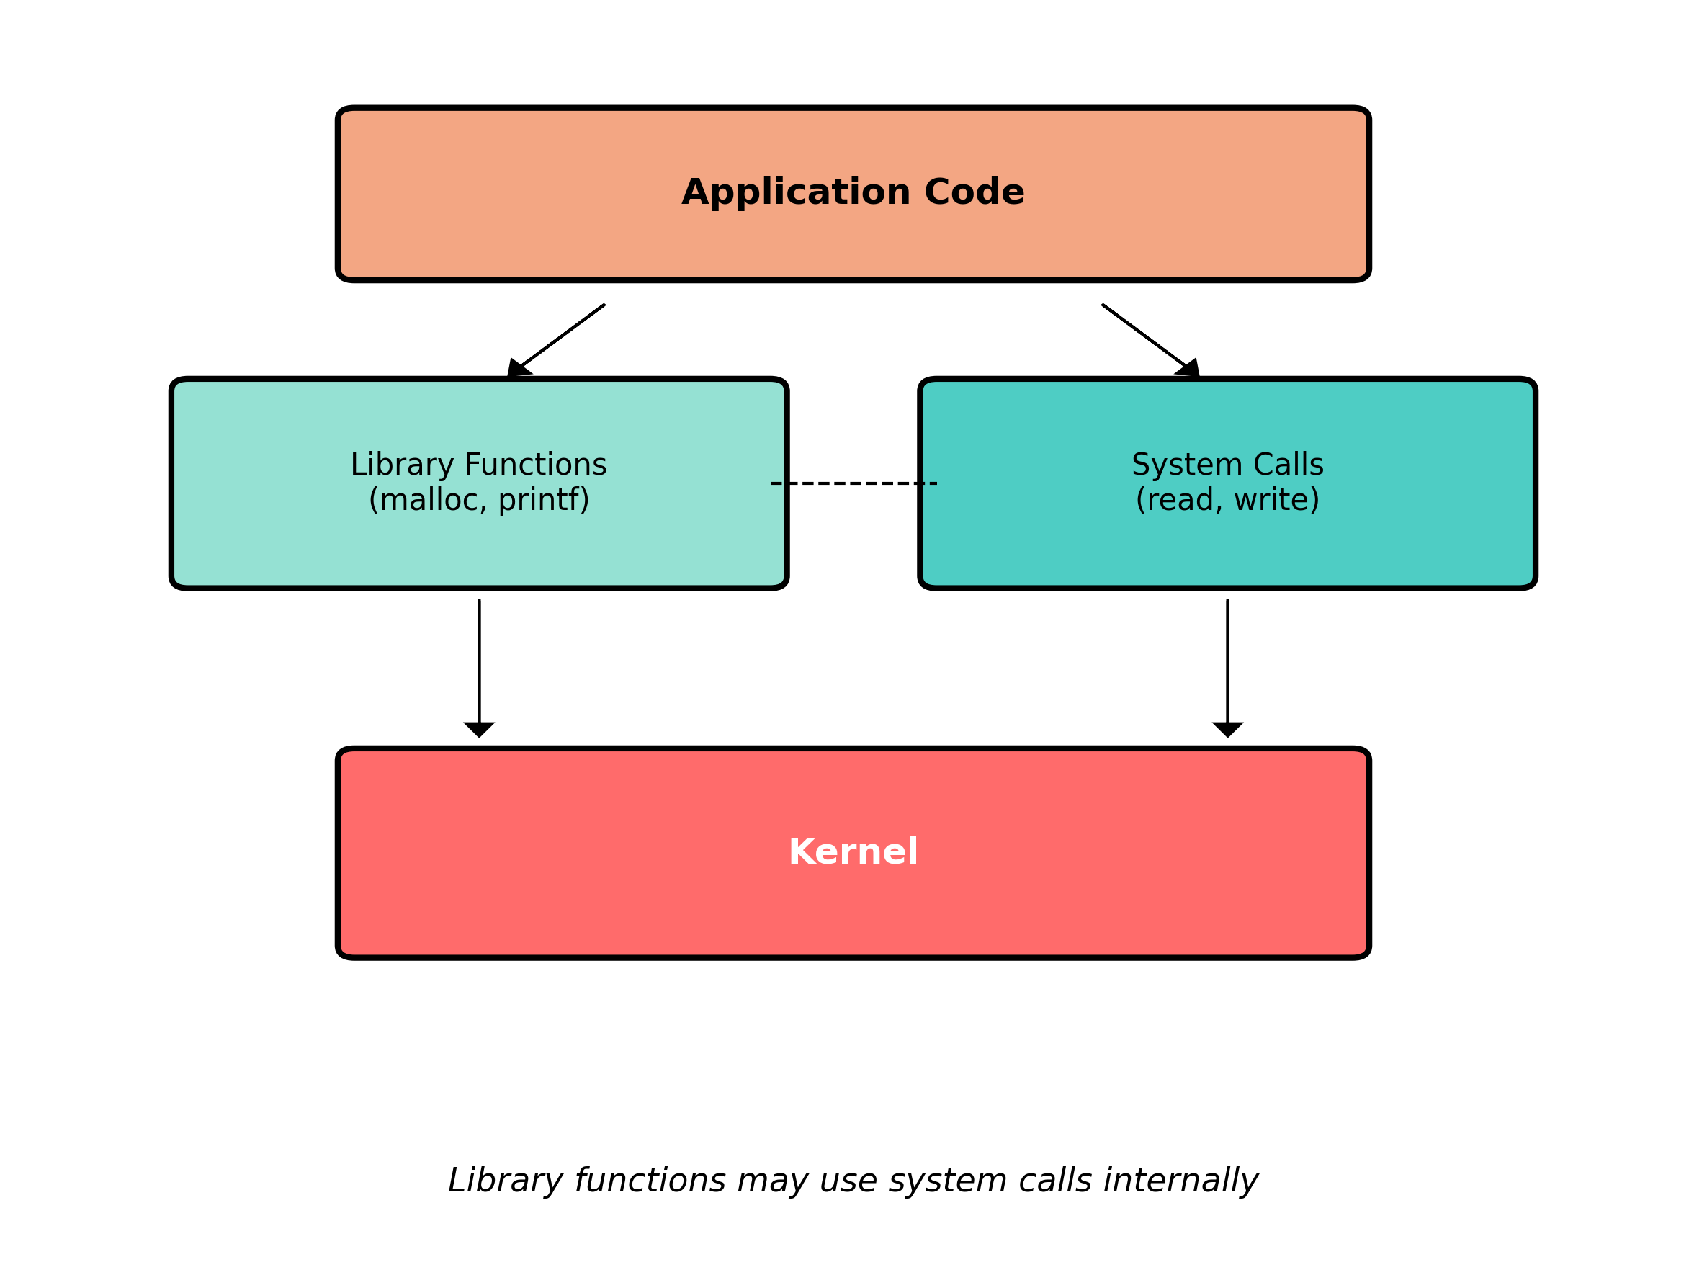
System Calls vs Library Functions
Notes:
System calls and library functions serve different purposes in the UNIX environment:
1. System Calls:
• Direct entry points into the kernel
• Provide the fundamental interface to kernel services
• Implemented in the kernel
• Limited in number (typically 100-400 depending on the system)
• Documented in Section 2 of the UNIX manual (man 2 command)
• Examples: open(), read(), write(), fork(), exec()
• Cannot be replaced or modified by users
2. Library Functions:
• Part of the standard C library or other libraries
• Run entirely in user space (except when they call system calls)
• Much more numerous than system calls
• Documented in Section 3 of the UNIX manual (man 3 command)
• Examples: printf(), scanf(), malloc(), strcpy()
• Can be replaced with custom implementations
3. Relationship:
• Many library functions use system calls internally
• For example, printf() ultimately calls the write() system call
• Library functions often provide a more convenient interface
• They add functionality like buffering, formatting, and error handling
• Applications can use both directly, depending on their needs
The diagram shows how an application can either call library functions (which may then call system calls) or call system calls directly. This layered approach provides both convenience and flexibility.

Slide 19
System Calls vs Library Functions
System Calls:
• Direct kernel interface
• Minimal functionality
• Cannot be replaced
• Examples: open, read, write, fork
Library Functions:
• Built on system calls
• More elaborate functionality
• Can be replaced/customized
• Examples: fopen, printf, malloc
Example: malloc (library) uses sbrk (system call)
Notes:
Key differences between system calls and library functions:
1. System Calls:
• Provide direct access to kernel services
• Offer minimal, focused functionality
• Cannot be replaced or modified by users
• Require privilege mode switching (user mode to kernel mode)
• Generally provide lower-level abstractions
• Examples:
- open(): Opens a file and returns a file descriptor
- read()/write(): Transfer data to/from a file descriptor
- fork(): Creates a new process
- exec(): Replaces the current process image
- socket(): Creates a network communication endpoint
2. Library Functions:
• Run entirely in user space (except when they call system calls)
• Often provide more elaborate functionality
• Can be replaced with custom implementations
• No mode switching unless they call system calls
• Generally provide higher-level abstractions
• Examples:
- fopen(): Opens a file and sets up buffering
- printf(): Formats and outputs data
- malloc(): Manages memory allocation
- system(): Executes a shell command
- qsort(): Sorts an array
3. Classic Example - Memory Allocation:
• sbrk() system call: Simply increases/decreases the process's memory space
• malloc() library function: Implements sophisticated memory management on top of sbrk()
• malloc() handles finding free blocks, splitting and coalescing blocks, and minimizing fragmentation
• This separation of concerns allows for different memory allocation strategies without changing the kernel
This distinction illustrates the UNIX philosophy of providing simple mechanisms in the kernel and building more complex functionality at the user level.

Slide 20
Summary
Key UNIX Concepts:
• Layered architecture with kernel at core
• Everything is a file
• Process-based execution model
• Standard I/O descriptors (0, 1, 2)
• Signal-based communication
• User/group based security
• Rich set of system calls and libraries
These fundamentals form the foundation for
advanced UNIX programming
Notes:
To summarize the key concepts of UNIX systems:
1. Layered Architecture: UNIX has a clear separation between the kernel, system calls, libraries, and applications. This modular design promotes flexibility and maintainability.
2. Everything is a File: UNIX provides a unified interface for accessing different types of resources (regular files, directories, devices, sockets, etc.) through the file abstraction. This simplifies programming and promotes consistency.
3. Process-based Execution: Processes are the fundamental unit of execution. The fork/exec model provides a flexible way to create new processes and run programs.
4. Standard I/O: The concepts of standard input, output, and error provide a consistent way for programs to communicate with users and other programs.
5. Signals: The signal mechanism allows for asynchronous communication between processes and handling of exceptional conditions.
6. User/Group Security: The user and group ID system provides a simple but effective security model for controlling access to resources.
7. Rich API: The combination of system calls and library functions provides a comprehensive programming interface for developing applications.
These fundamental concepts have stood the test of time. Despite being developed in the early 1970s, UNIX's design principles continue to influence modern operating systems, including Linux, macOS, Android, and even Windows to some extent.
Understanding these concepts is essential for effective UNIX/Linux programming and system administration. They form the foundation upon which more advanced topics build.

